Slide 1
COMP0005 – ALGORITHMS 2.3 Quick Sort
Prof Licia Capra
Dept of Computer Science

Slide 2
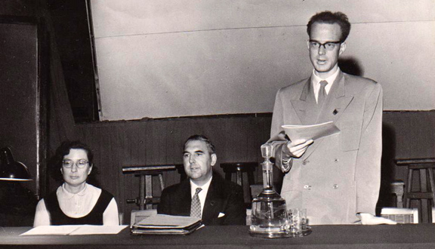
CONTENT
Elementary Sorts
MergeSort
QuickSort
HeapSort
Tony Hoare
https://tinyurl.com/y4vz5twh

Slide 3
QUICK sort
Key idea
Shuffle the array a[]
Partition a[] so that, for some j
Entry a[j] is in place
a[i]<= a[j] for any i<j
a[i]>=a[j] for any i>j
Sort each partition recursively
Input array
Q | U | I | C | K | S | O | R | T | E | X | A | M | P | L | E
Shuffle
K | R | A | T | E | L | E | P | U | I | M | Q | C | X | O | S
partitioning item
Partition
E | C | A | I | E | K | L | P | U | T | M | Q | R | X | O | S
not grater
not smaller

Slide 4
QUICK sort
Key idea
Shuffle the array a[]
Partition a[] so that, for some j
Entry a[j] is in place
a[i]<= a[j] for any i<j
a[i]>=a[j] for any i>j
Sort each partition recursively
Input array
Q | U | I | C | K | S | O | R | T | E | X | A | M | P | L | E
Shuffle
K | R | A | T | E | L | E | P | U | I | M | Q | C | X | O | S
Partition
E | C | A | I | E | K | L | P | U | T | M | Q | R | X | O | S
Sort left
A | C | E | E | I | K | L | P | U | T | M | Q | R | X | O | S
Sort right
A | C | E | E | I | K | L | M | O | P | Q | R | S | T | U | X
Result
A | C | E | E | I | K | L | M | O | P | Q | R | S | T | U | X

Slide 5
QUICK SORT
Partitioning step
Pivoting (i.e., partitioning) element: a[lo]
Repeat until i and j cross
Scan i from left to right so long as a[i] < a[lo]
Scan j from right to left so long as a[j] > a[lo]
Swap a[i] with a[j]
Swap a[lo] with a[j]
Shuffled array
K | R | A | T | E | L | E | P | U | I | M | Q | C | X | O | S
pivot
a[lo]
i
j

Slide 6
QUICK SORT
Partitioning step
Pivoting (i.e., partitioning) element: a[lo]
Repeat until i and j cross
Scan i from left to right so long as a[i] < a[lo]
Scan j from right to left so long as a[j] > a[lo]
Swap a[i] with a[j]
Swap a[lo] with a[j]
Shuffled array
K | C | A | T | E | L | E | P | U | I | M | Q | R | X | O | S
pivot
a[lo]
i
j

Slide 7
QUICK SORT
Partitioning step
Pivoting (i.e., partitioning) element: a[lo]
Repeat until i and j cross
Scan i from left to right so long as a[i] < a[lo]
Scan j from right to left so long as a[j] > a[lo]
Swap a[i] with a[j]
Swap a[lo] with a[j]
Shuffled array
K | C | A | I | E | L | E | P | U | T | M | Q | R | X | O | S
pivot
a[lo]
i
j

Slide 8
QUICK SORT
Partitioning step
Pivoting (i.e., partitioning) element: a[lo]
Repeat until i and j cross
Scan i from left to right so long as a[i] < a[lo]
Scan j from right to left so long as a[j] > a[lo]
Swap a[i] with a[j]
Swap a[lo] with a[j]
Shuffled array
K | C | A | I | E | E | L | P | U | T | M | Q | R | X | O | S
pivot
a[lo]
i
j

Slide 9
QUICK SORT
Partitioning step
Pivoting (i.e., partitioning) element: a[lo]
Repeat until i and j cross
Scan i from left to right so long as a[i] < a[lo]
Scan j from right to left so long as a[j] > a[lo]
Swap a[i] with a[j]
Swap a[lo] with a[j]
Shuffled array
K | C | A | I | E | E | L | P | U | T | M | Q | R | X | O | S
pivot
a[lo]
j
i

Slide 10
QUICK SORT
Partitioning step
Pivoting (i.e., partitioning) element: a[lo]
Repeat until i and j cross
Scan i from left to right so long as a[i] < a[lo]
Scan j from right to left so long as a[j] > a[lo]
Swap a[i] with a[j]
Swap a[lo] with a[j]
Shuffled array
E | C | A | I | E | K | L | P | U | T | M | Q | R | X | O | S
j
a[j] is in position

Slide 11
Quick sort
Pseudocode – partition step
partition(a[], lo, hi):
i = lo;
j = hi+1;
p = a[lo]
while (true)
while (a[++i] < p)
if (i == hi) break;
while (p < a[--j])
if (j == lo) break;
if (i >= j) break;
swap(a[i], a[j]);
swap(a[lo], a[j]);
return j;
find item on the left to swap
find item on the right to swap
check if pointers crossed
swap
put the pivot element in place
return index of item now known to be in place

Slide 12
Quick sort
Pseudocode – partition step
partition(a[], lo, hi):
i = lo;
j = hi+1;
p = a[lo]
while (true)
while (a[++i] < p)
if (i == hi) break;
while (p < a[--j])
if (j == lo) break;
if (i >= j) break;
swap(a[i], a[j]);
swap(a[lo], a[j]);
return j;
before
p
lo
hi
during
p <=p >=p
i
j
after
<=p p >=p
lo
j
hi

Slide 13
Quick sort
Pseudocode – recursive call
sort(a[], lo, hi):
if (hi <= lo) return;
j = partition(a, lo, hi);
sort(a, lo, j-1);
sort(a, j+1, hi);
randomShuffle(a);
sort(a, 0, a.length-1);

Slide 14
Quick sort
Pseudocode – recursive call
sort(a[], lo, hi):
if (hi <= lo) return;
j = partition(a, lo, hi);
sort(a, lo, j-1);
sort(a, j+1, hi);
randomShuffle(a);
sort(a, 0, a.length-1);

Slide 15
Quick sort
Empirical Analysis
Laptop: 10⁸ compares/second.
Supercomputer: 10¹² compares/second.
 | Insertion Sort (N²) |  |  | Merge Sort (N log N) |  |  | Quick Sort (N log N)
computer | ~k | ~M | ~G | ~k | ~M | ~G | ~k | ~M | ~G
home | instant | hours | years | instant | 1 second | 18 minutes | instant | 0.6 seconds | 12 minutes
super | instant | seconds | weeks | instant | instant | instant | instant | instant | instant

Slide 16
Quick sort
Analysis
Average-case: number of compares ~ N lg N
Worst-case: number of compares N+(N-1)+(N-2)+…+1 ~ 1/2 N²
lo | j (pivot) | hi
0 | 0 | 26
1 | 1 | 26
2 | 2 | 26
3 | 3 | 26
4 | 4 | 26
5 | 5 | 26
… | … | …
26 | 26 | 26
A | B | C | D | E | F | G | H | … | Z

Slide 17
Quick sort
Practical Improvements
Use insertion sort on small subarrays (<10 items)
Best choice pivot = median value
Estimate true median by taking median of sample (e.g., median of 3 random items)

Slide 18
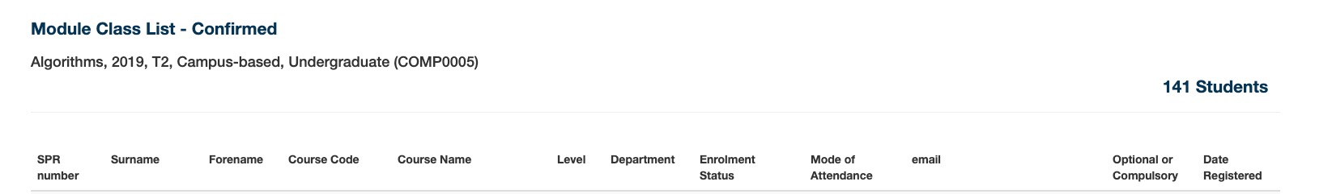
Quick sort vs mergesort
Some properties
Quick sort is an in-place algorithm
Quick sort is not stable
Quick sort running time on duplicate keys could be quadratic

Slide 19
Quick sort vs mergesort
Some properties
Quick sort is an in-place algorithm
Quick sort is not stable
Quick sort running time on duplicate keys could be quadratic
MUST: during partitioning, stop scan on items equal to pivot
SHOULD: during partitioning, pull all items equal to pivot in-place
before
p
lo
hi
after
<=p p >=p
after
<p =p >p
lo
hi
lo
hi

Slide 20
CONTENT – recap
Elementary Sorts
MergeSort
QuickSort
HeapSort

